Slide 1

Principles of Web Design 6th Edition
Chapter 7 – Page Layouts

Slide 2
Objectives
Understand the normal flow of elements
Use the division element to create content containers
Create floating layouts
Build a flexible page layout
Build a fixed page layout

Slide 3
Understanding the Normal Flow of Elements

Slide 4
Understanding the Normal Flow
The normal flow determines the sequence of element display
Boxes are laid out vertically one after the other, beginning at the top of the containing box
Each box horizontally fills the browser window

Slide 5
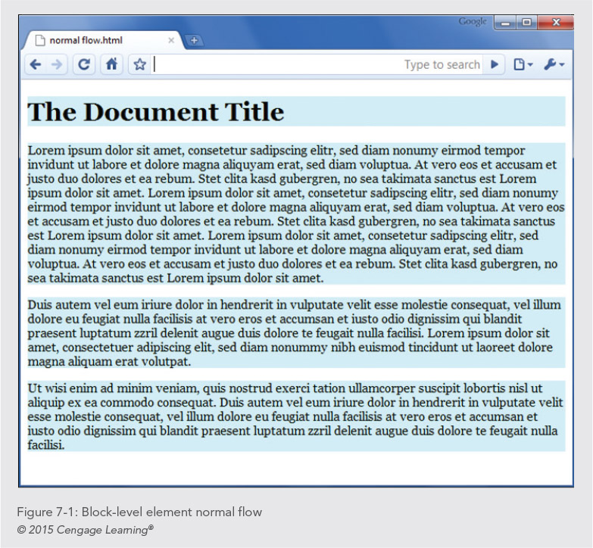

Slide 6
Understanding the Normal Flow
In the normal flow for inline elements, boxes are laid out horizontally beginning at the top left of the containing block
The inline boxes comprise the lines of text within, for example, a <p> element

Slide 7
Floating an Element
When you float an element, you take it out of the normal flow
Check the results frequently as you are designing your layout using floats

Slide 8
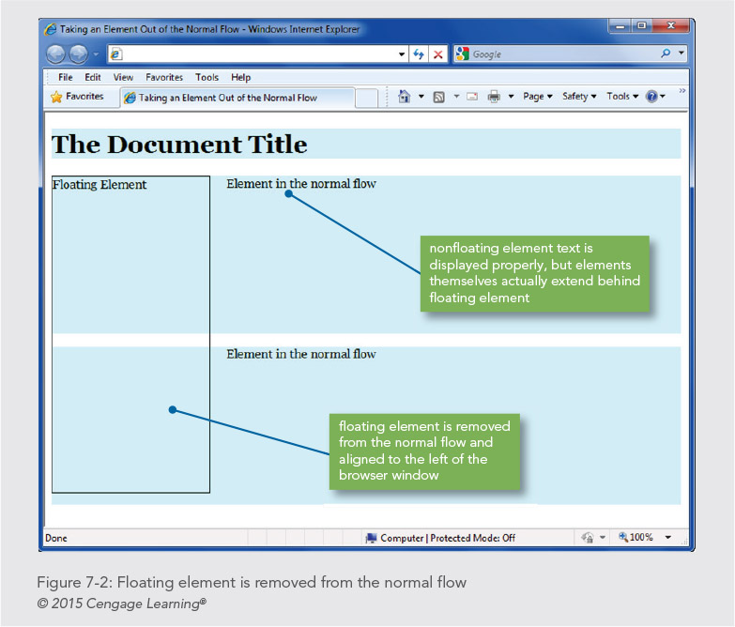

Slide 9
Creating Content Containers

Slide 10
Creating Content Containers
Use the sectioning elements and occasionally <div> elements to create content sections

Slide 11
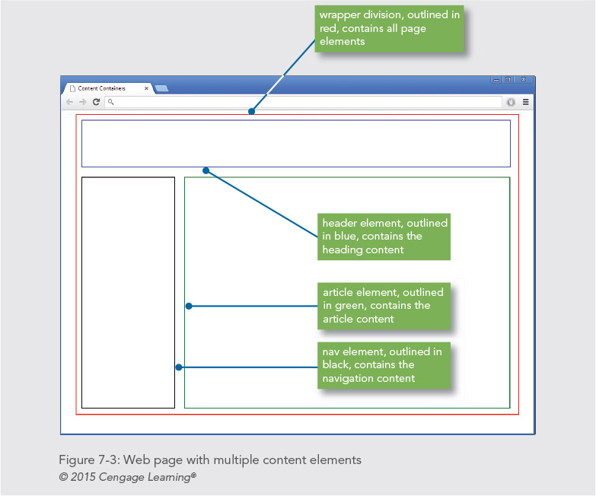

Slide 12
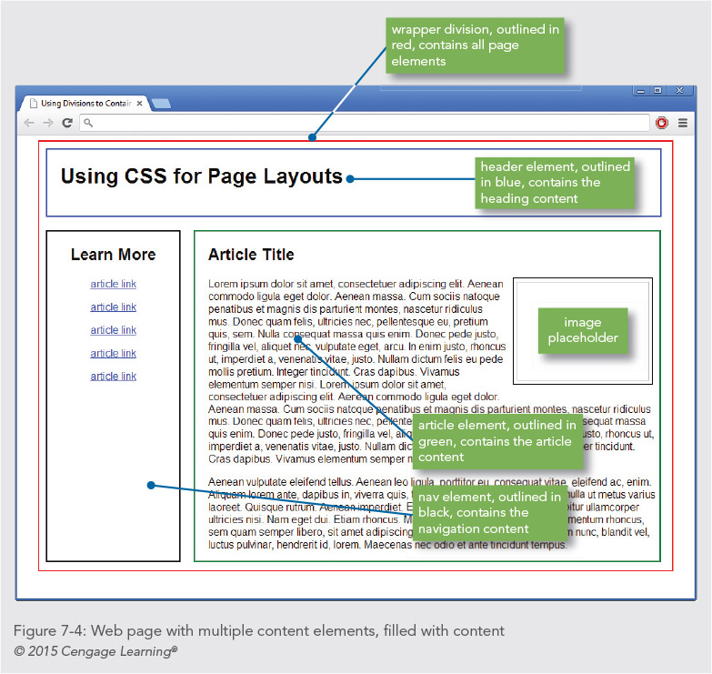

Slide 13
Choosing the Correct Content Element
The <div> element has no special meaning; use it only as a container style purposes, as in a page wrapper
<section> is a thematic section of a document with a heading
<article> is a reusable section of content
Be consistent when using these elements

Slide 14
Creating Floating Layouts

Slide 15
Creating Floating Layouts
The float property lets you build columnar layouts
You can align content elements to either the right or left side of the browser window
A typical Web page design can contain both floating and non-floating elements
Remember to always use a width property for floating elements

Slide 16
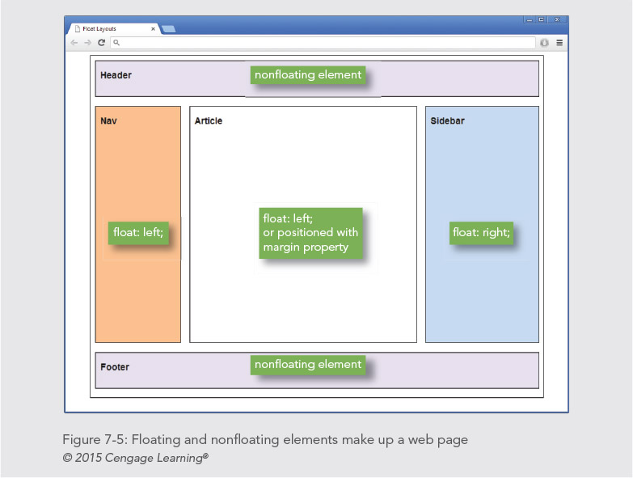

Slide 17
Creating Floating Layouts
Building floating layouts requires that you choose a method for containing the floating elements
You will often see that the floating elements extend beyond their containing elements, which will result in a “broken” layout

Slide 18
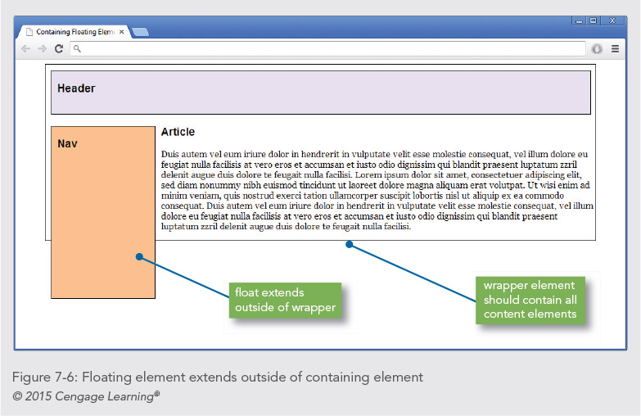

Slide 19
Solution 1: Using a Normal Flow Element
If you have multiple columns, at least one needs to be non-floating (in the normal flow)
The non-floating element must be positioned with the margin properties

Slide 20
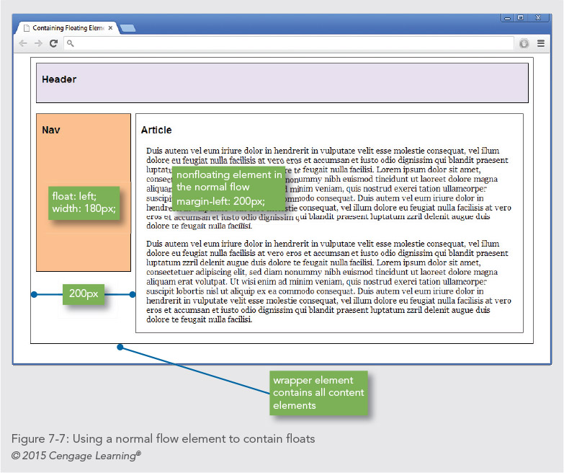

Slide 21
Solution 2: Using the Clear Property
Use a non-floating footer element (in the normal flow), with the clear property set to both

Slide 22
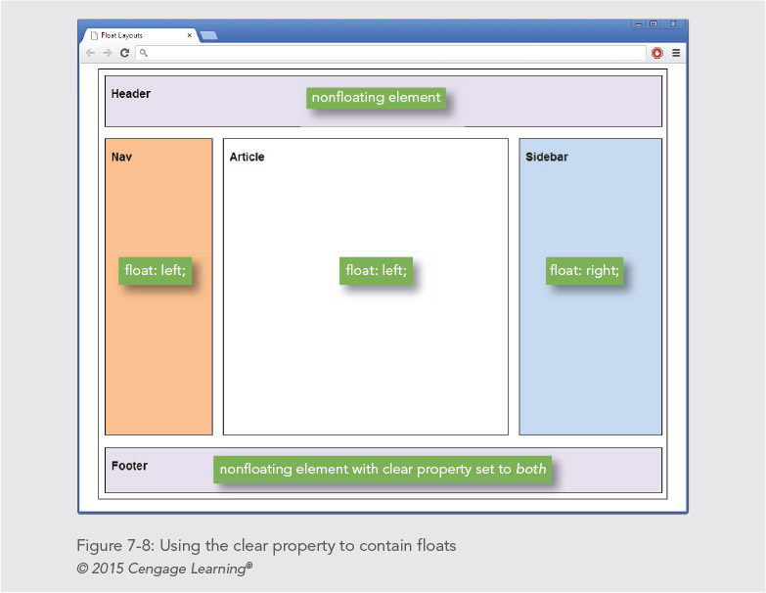

Slide 23
Floating Elements within Floats
Floating elements give you a wide variety of options for building interesting page layouts
If you are floating an element within another element, the order of the elements is important

Slide 24
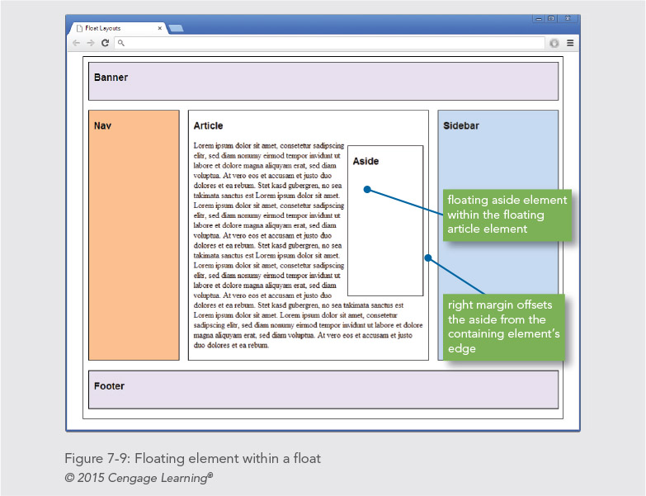

Slide 25
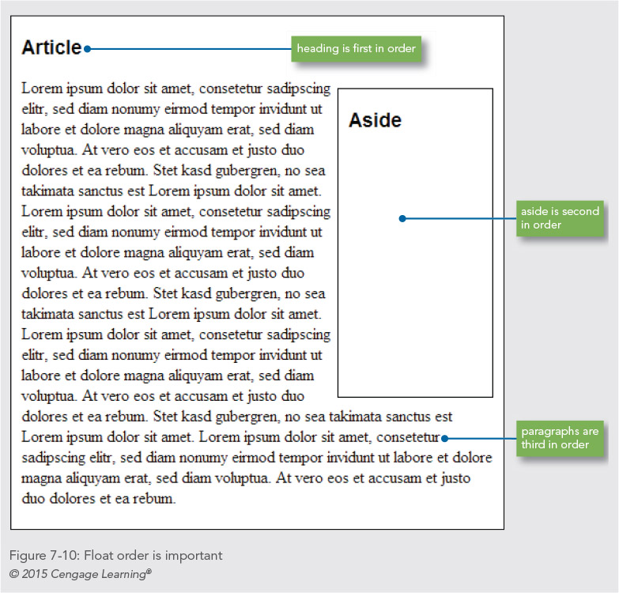

Slide 26
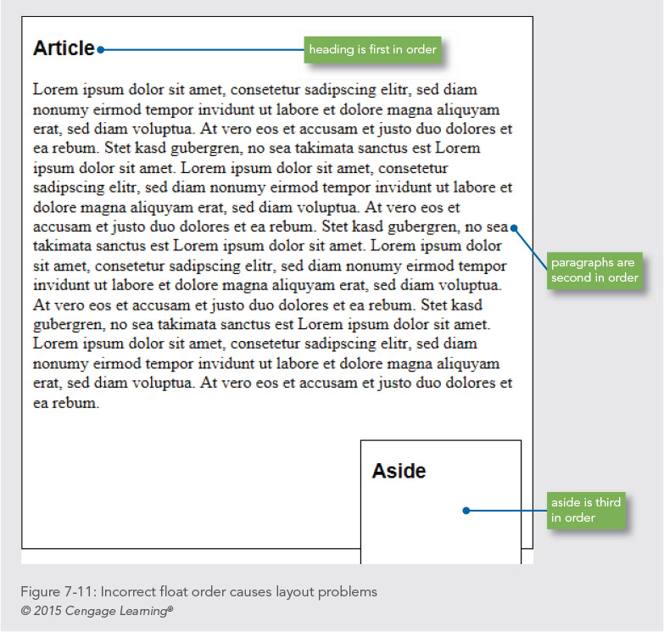

Slide 27
Fixing Column Drops
Column drops occur when the total width of the columnar elements in a page layout exceeds the width of their containing element

Slide 28
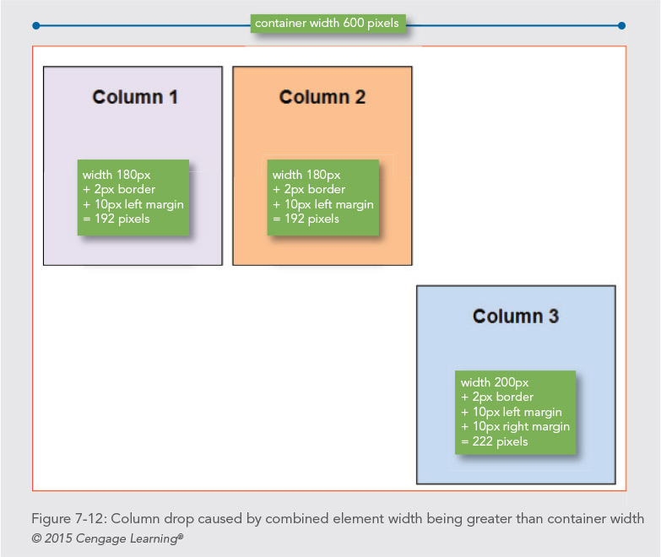

Slide 29
Clearing Problem Floats
Floats occasionally do not appear exactly where you want them to appear
The clear property can solve this problem

Slide 30
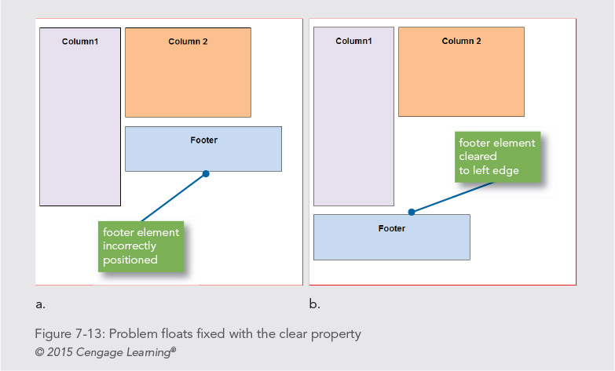

Slide 31
Building a Flexible Page Layout

Slide 32
Building a Flexible Page Layout
Flexible layouts adapt to the size of the browser window
With a flexible layout, your content has to adapt and look good at a wide range of layout sizes
Flexible layouts are the basis for responsive layouts used for mobile devices

Slide 33
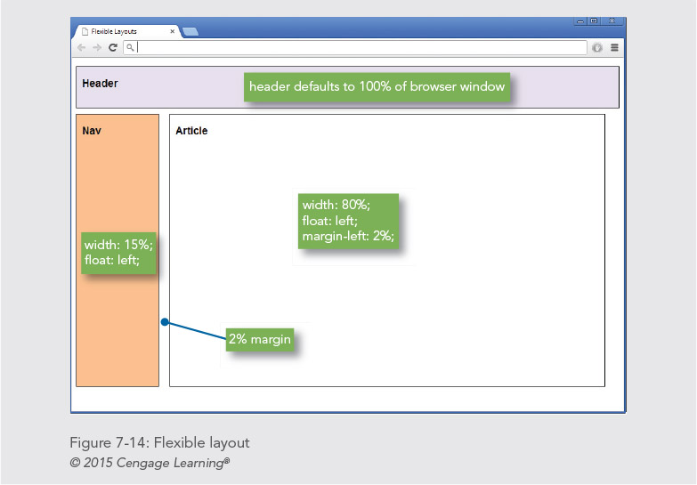

Slide 34
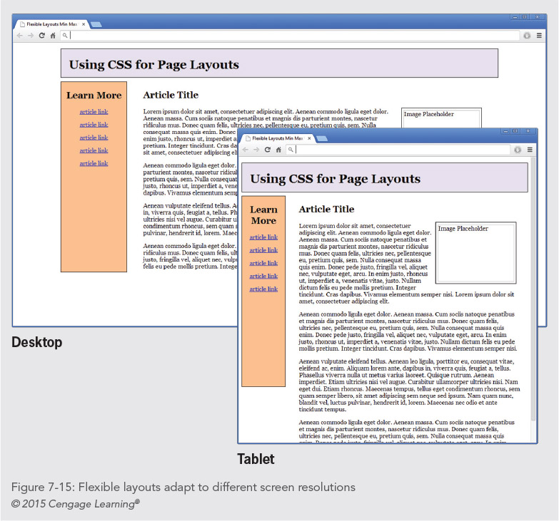

Slide 35
Controlling Flexible Layout Width
You can control the compression and expansion of your content in a flexible layout by setting minimum and maximum widths
div.wrapper {
width: 100%;
min-width: 750px;
max-width: 1220px;
}

Slide 36
Building a Fixed Page Layout

Slide 37
Building a Fixed Page Layout
Fixed layouts remain constant despite the resizing of the browser in different screen resolutions and monitor sizes
Many designers prefer fixed layouts because they have more control over the finished design
Fixed layouts are normally contained by a wrapper element that controls the page width and centers the page in the browser window

Slide 38
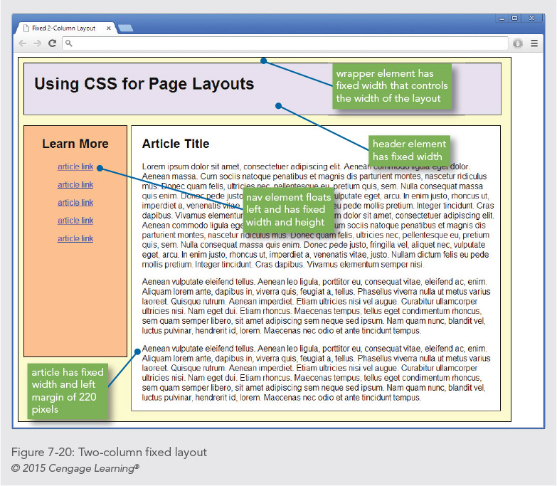

Slide 39
Controlling Fixed Layout Centering
A wrapper division lets you automatically center the layout in the browser
This is a great solution for wide-screen monitors
Automatic centering is a simple use of the margin property
#wrapper {
width: 960px;
margin-left: auto;
margin-right: auto;
border: thin solid black;
background-color: #ffc;
}

Slide 40
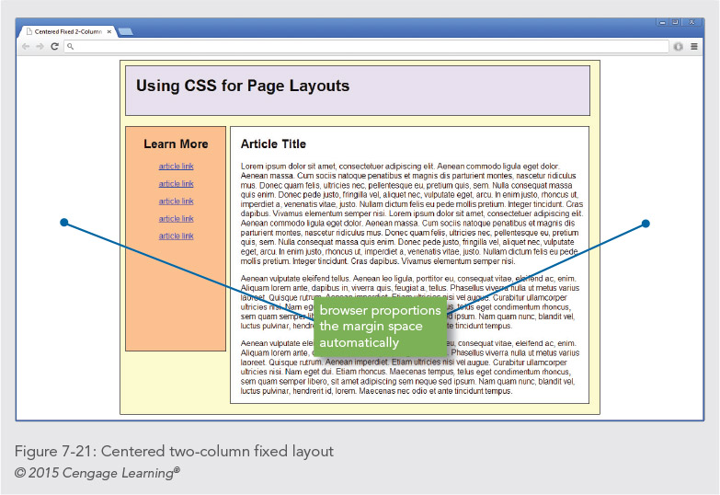

Slide 41
Summary
The normal flow dictates the way in which elements normally are displayed in the browser window
When you remove an element from the normal flow, you may see unexpected behavior from other elements
Remember to always use a width property for floating elements
Remember to avoid using the height property
For fixed layouts, content elements are usually contained with a wrapper element that sets the width for the page layout

